Slide 1


Laying foundations to quantify the "Effort of Reproducibility"
Akhil Pandey Akella
Northern Illinois University
Dekalb, IL, USA
aakella@niu.edu
David Koop
Northern Illinois University
Dekalb, IL, USA
dakoop@niu.edu
Hamed Alhoori
Northern Illinois University
Dekalb, IL, USA
alhoori@niu.edu
Notes:
Good afternoon everyone,
Welcome to the Session on Scientometrics. My name is Akhil, a Ph.D. student from Northern Illinois University, and I am here to present our work on Laying foundations to quantify the “Effort of Reproducibility.”

Slide 2
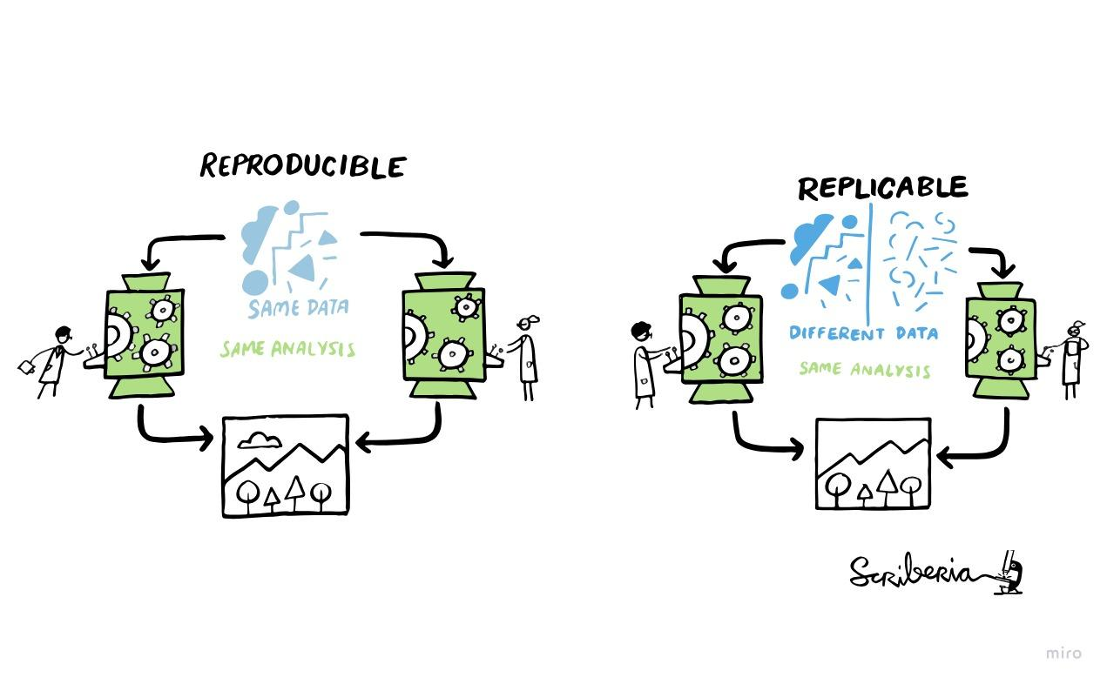
What is Reproducibility ?
This illustration is created by Scriberia with The Turing Way community. Used under a CC-BY 4.0 licence. DOI: 10.5281/zenodo.3332807.
Notes:
The definition of Reproducibility is often used interchangeably with replicability, and when you change the discipline, what it means to be reproducible can differ. So for the sake of standardization, we borrow NAS’s taxonomy to define Reproducibility as the process of obtaining consistent computational results using the same input data, computational steps, methods, code, and conditions of analysis.

Slide 3
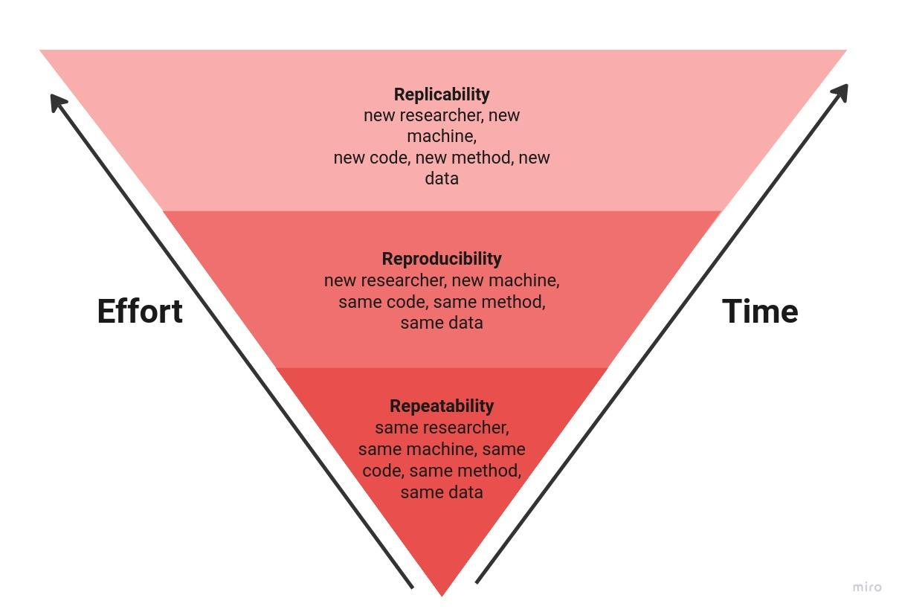
Effort of Reproducibility
Based of an infographic from Essawy et. al, “A Taxonomy for Reproducible and Replicable Research in Environmental Modelling”, 2020, https://doi.org/10.1016/j.envsoft.2020.104753.
Notes:
Assessing the claims made in a scientific paper is an elaborate process that involves researchers investing considerable time and effort to discover the validity of claims. Additionally, validating these claims involves a three-step process that includes repeatability, reproducibility, and replicability, where each subsequent step requires increased effort and time. We focus on researching the effort of reproducibility, where a new researcher reproduces the original work on a new machine using the same code, methods, and data. This area is impactful because it balances human effort and time to assess validity and confidence levels in scientific work.
Validating scientific claims is an arduous process involving repeatability, reproducibility, and replicability. Our research concentrates on reproducibility, where a new researcher duplicates original work using identical code, methods, and data on a different machine. This aspect is significant as it balances effort and time to evaluate the credibility of scientific work.

Slide 4
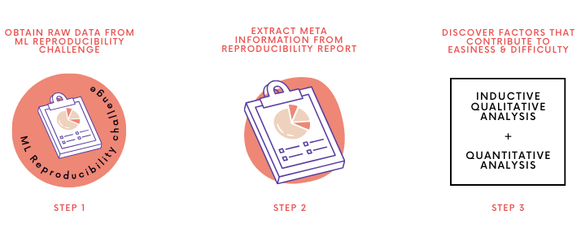
Quantifying the ‘Effort of Reproducibility’
Notes:
Quantifying the underlying effort in reproducing scientific work would require a community of researchers to reproduce claims made in scientific articles. Analyzing the reports of this exercise can be a good starting point for understanding the operational framework of the research effort.Our study consists of three facets: "Data Collection, Information Extraction, and Comprehensive Analysis." Let us explore each one of these sections.

Slide 5
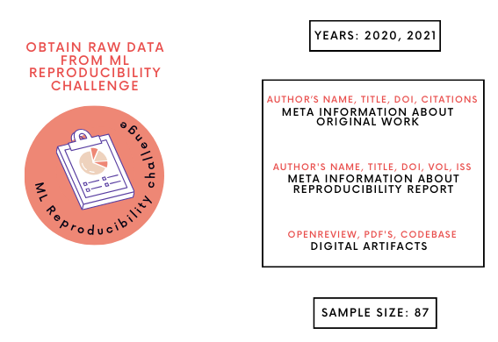
Data Collection
Notes:
Our study focused on collecting data from Machine Learning Reproducibility Challenge for the years 2020 and 2021 due to their emphasis on the publication of reliable, reproducible scientific results. We chose these years as the reproducibility reports followed a structured template. These reproducibility reports were published as peer reviewed articles on an open acces journal called ReScience.. We collected meta-information about the original work and the reproducibility reports, and reviewed digital artifacts related to the study's reproducibility available on the OpenReview portal.

Slide 6
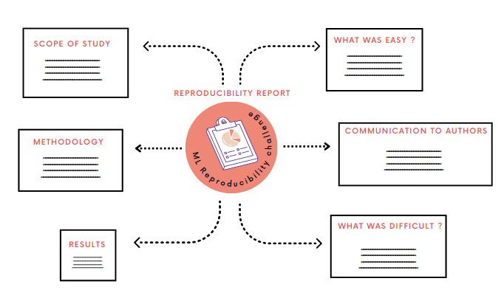
Information Extraction
Notes:
Allen-AI’s Science Parse software package to parse all of the sections of the reproducibility report, transforming the data into a structured form.

Slide 7
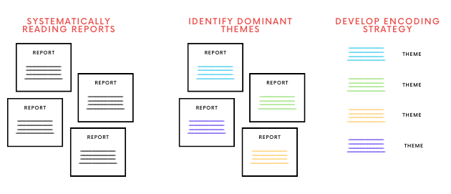
Inductive Analysis

Slide 8
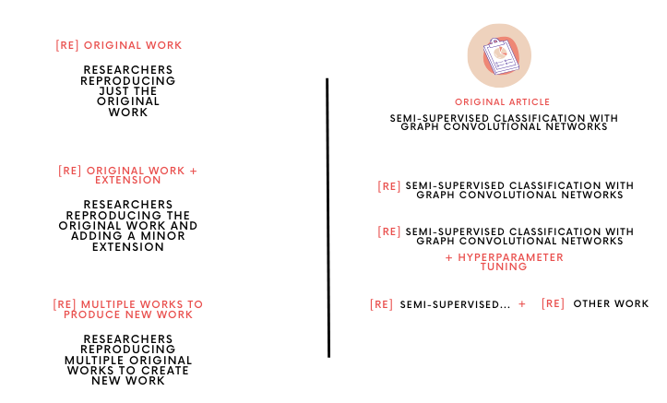
Scope of reproducibility
Notes:
Original work: Straightforward implementations of the original work.
Original work with supplemental extensions: Implementations of the original work and additional contributions, such as the inclusion of an ablation study.
Reproducing more than one work to build new work: Implementations of more than one original work to support a completely new idea.

Slide 9
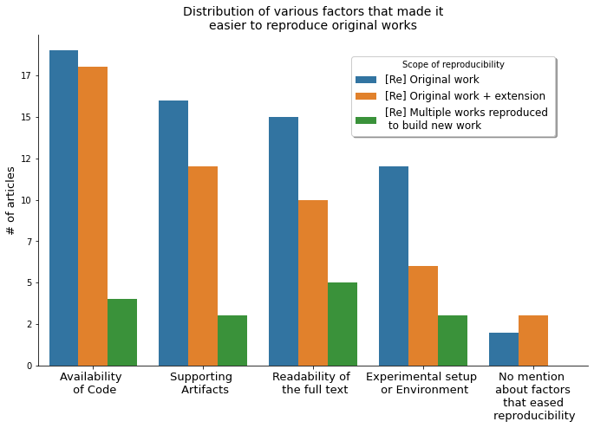
Reasons that made it easy
Notes:
Identifying reasons for easiness or difficulty is a pursuit that is both contextual and subjective. Under contextual reasons for easiness, The plot suggests that the Availability of Code and Supporting Artifacts are the most important contextual factors that make it easier for a researcher to replicate original works. Under subjective reasons for easiness or difficulty, we can notice from Fig. that the Readability of the full text is a crucial subjective factor that eased the effort to reproduce the original study. Also, it is interesting to notice a shift
in priority over reasons for easiness or difficulty for studies whose scope is Reproducing more than one work to build new work. For instance, in Fig 1, the Readability of the full text is mentioned more as a reason than the most prevailing factor, the Availability of Code.

Slide 10
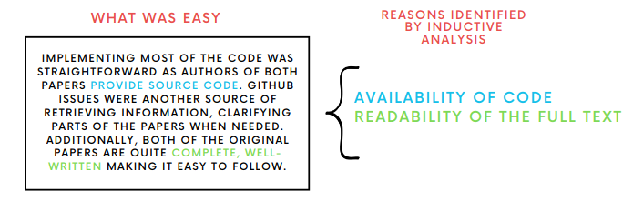
Reasons that made it easy

Slide 11
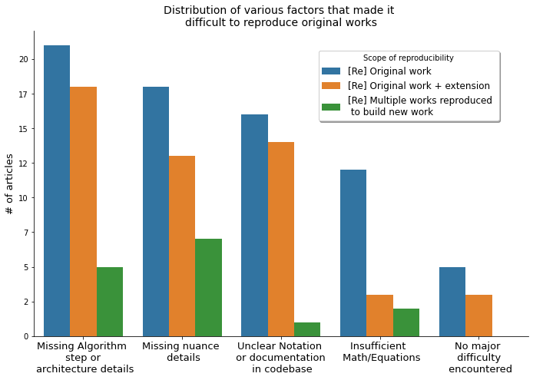
Reasons that made it difficult

Slide 12
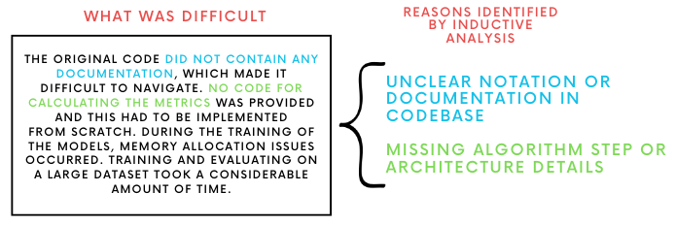
Reasons that made it difficult

Slide 13
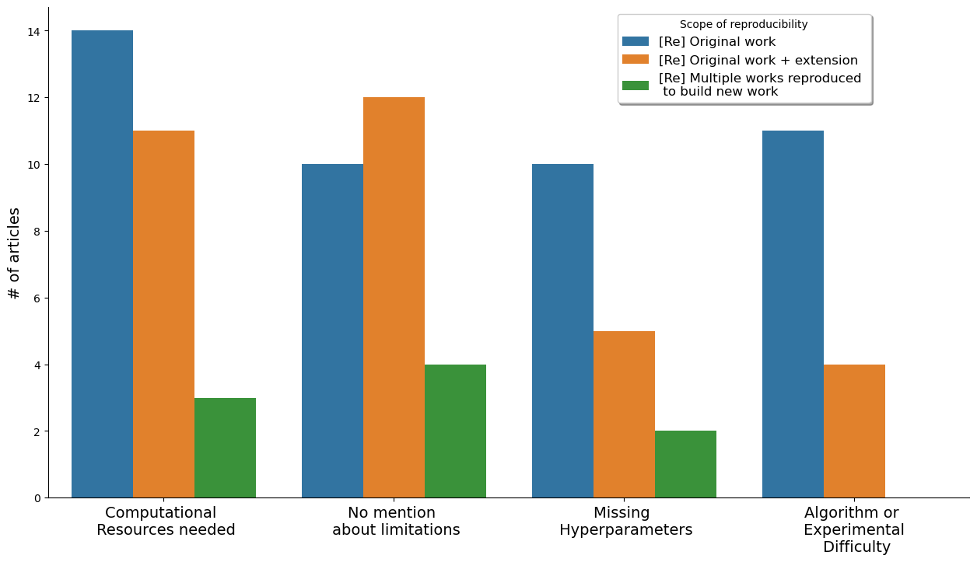
Limitations
Notes:
These are external factors that restrict or limit the evaluation of reproducibility. They don't necessarily make the reproduction of the study more difficult, but they can prevent a researcher from fully evaluating the reproducibility of the original study. Examples of limitations can include the necessity of specific computational resources that may not be readily available to all researchers, missing hyperparameters that were not included in the original study, or the inherent complexity of the algorithm or experimental setup used in the original study.In other words, "Reasons for Difficulty" are issues that make the process of reproducing a study more difficult, while "Limitations" are factors that restrict the ability to fully evaluate the reproducibility of a study.

Slide 14
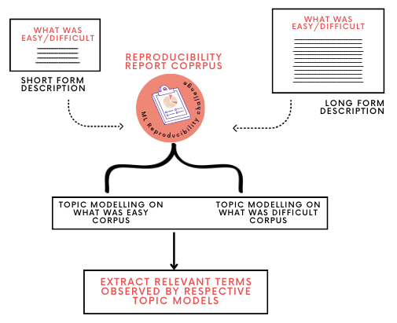
Quantitative Analysis

Slide 15
Relevant terms - ‘What was easy’ corpus
Topic | Most relevant terms
1 | describe, straightforward, understand, documented
2 | codebase, repository, source, instructions
3 | datasets, training, scripts, experiments
4 | results, ideas, evaluation, architecture
5 | correspondence, addressed, peer-review, copyright
Notes:
Topic 1: Understanding and Documentation - This topic seems to be about the clarity and straightforwardness of the original work, which made it easier to understand and reproduce.
Topic 2: Code Availability - This topic appears to be about the availability and accessibility of the codebase, including source code and instructions.
Topic 3: Experiment Replication - This topic seems to be about the availability of datasets, scripts, and the ability to conduct experiments, which facilitated the reproduction of the original work.
Topic 4: Result Evaluation - This topic appears to be about the evaluation of results, ideas, and architecture, which made the reproduction process easier.
Topic 5: Author Correspondence - This topic seems to be about the importance of communication with the original authors, which can significantly ease the effort of reproducibility.

Slide 16
Relevant terms - ‘What was difficult’ corpus
Topic | Most relevant terms
1 | dataset, algorithm, implementation, method
2 | training, loss, accuracy, learning
3 | models, network, training, time
4 | difficult, challenges, evaluation, claim
5 | methods, features, performance, parameters
Notes:
Topic 1- Implementation Challenges - This topic seems to be about the difficulties encountered in implementing the dataset, algorithm, or method from the original work.
Topic 2: Training Difficulties - This topic appears to be about the challenges faced during the training phase, including issues related to loss, accuracy, and learning.
Topic 3: Model Training Time - This topic seems to be about the difficulties related to the time taken to train models and networks.
Topic 4: Evaluation Challenges - This topic appears to be about the difficulties in evaluating the claims and challenges of the original work.
Topic 5: Performance Parameters - This topic seems to be about the difficulties in understanding and implementing the methods, features, performance metrics, and parameters of the original work

Slide 17
Conclusion
We have laid the groundwork to analyze and identify factors that encapsulate the effort required to reproduce scientific articles.
We found “Availability of Code” as one of the most important factors that made it easy to reproduce the original work.
We found “missing algorithm steps or architectural details” as one of the most important factors that made it difficult while reproducing the original work.
Studies under the scope “[Re] Multiple works reproduced to build new work” never mention “Algorithm or Experimental difficulty” as a subjective factor for limitation.
Our Topic model found “Communication with the original authors” as an additional factor that can ease the effort of reproducibility.
Quantifying the effort required to reproduce a study provides a valuable framework for future research in this area.

Slide 18



Artifacts
https://reproducibilityproject.github.io/effortly

Slide 19




Acknowledgement
Notes:
I would take this opportunity to thank NSF, SIGIR, DATA Lab, Northern illinois University.

Slide 20
End | fin

